Slide 1
Korean 101e-Portfolio (unit 5 & 6)

Slide 2
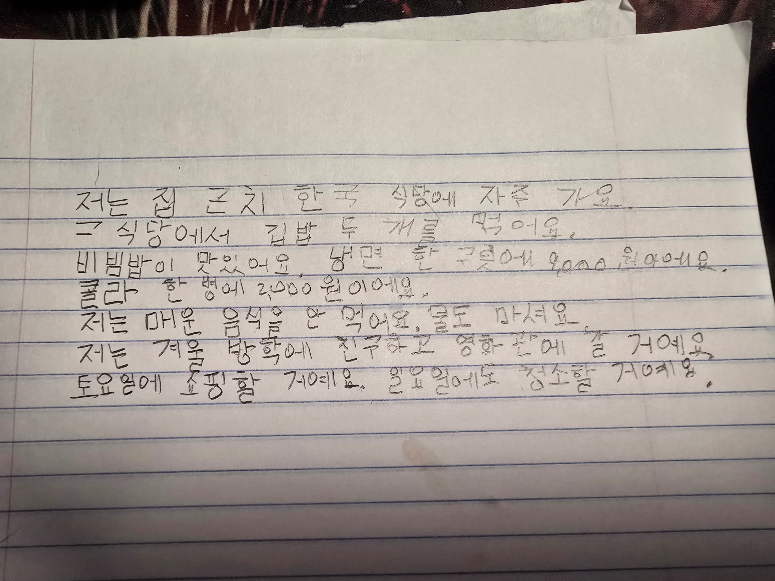

자주 가는 곳에서 먹는 음식 & 겨울 방학에 할 일

Slide 3
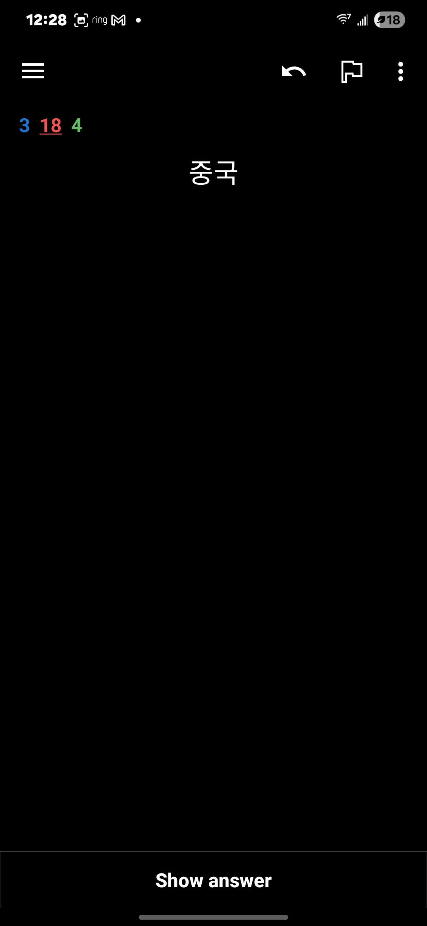
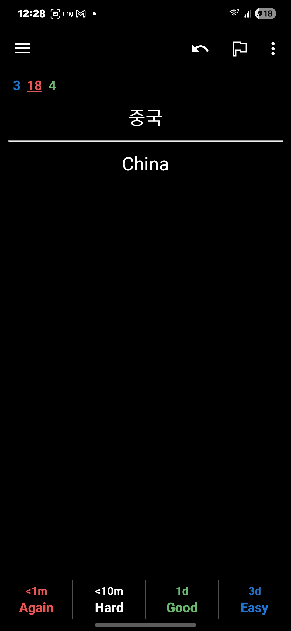
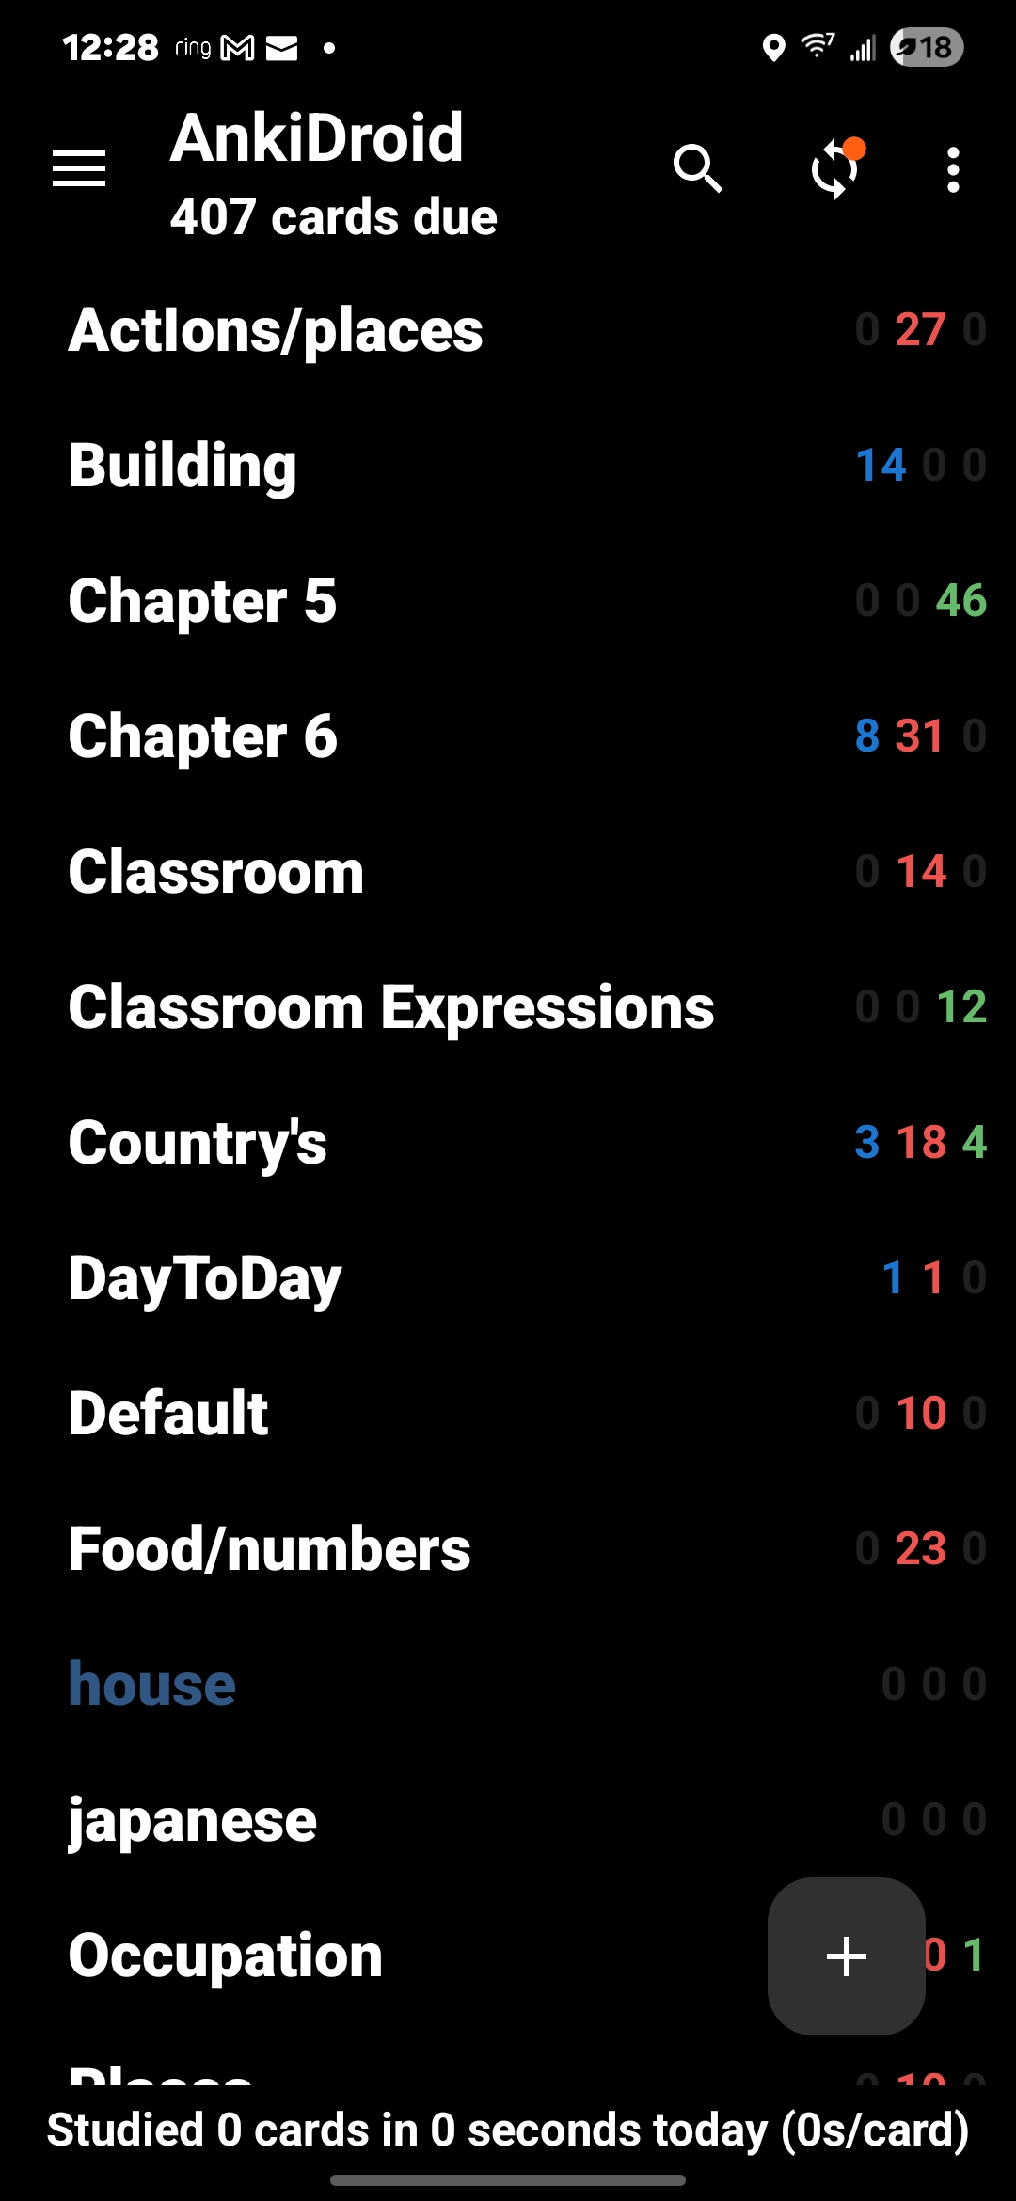
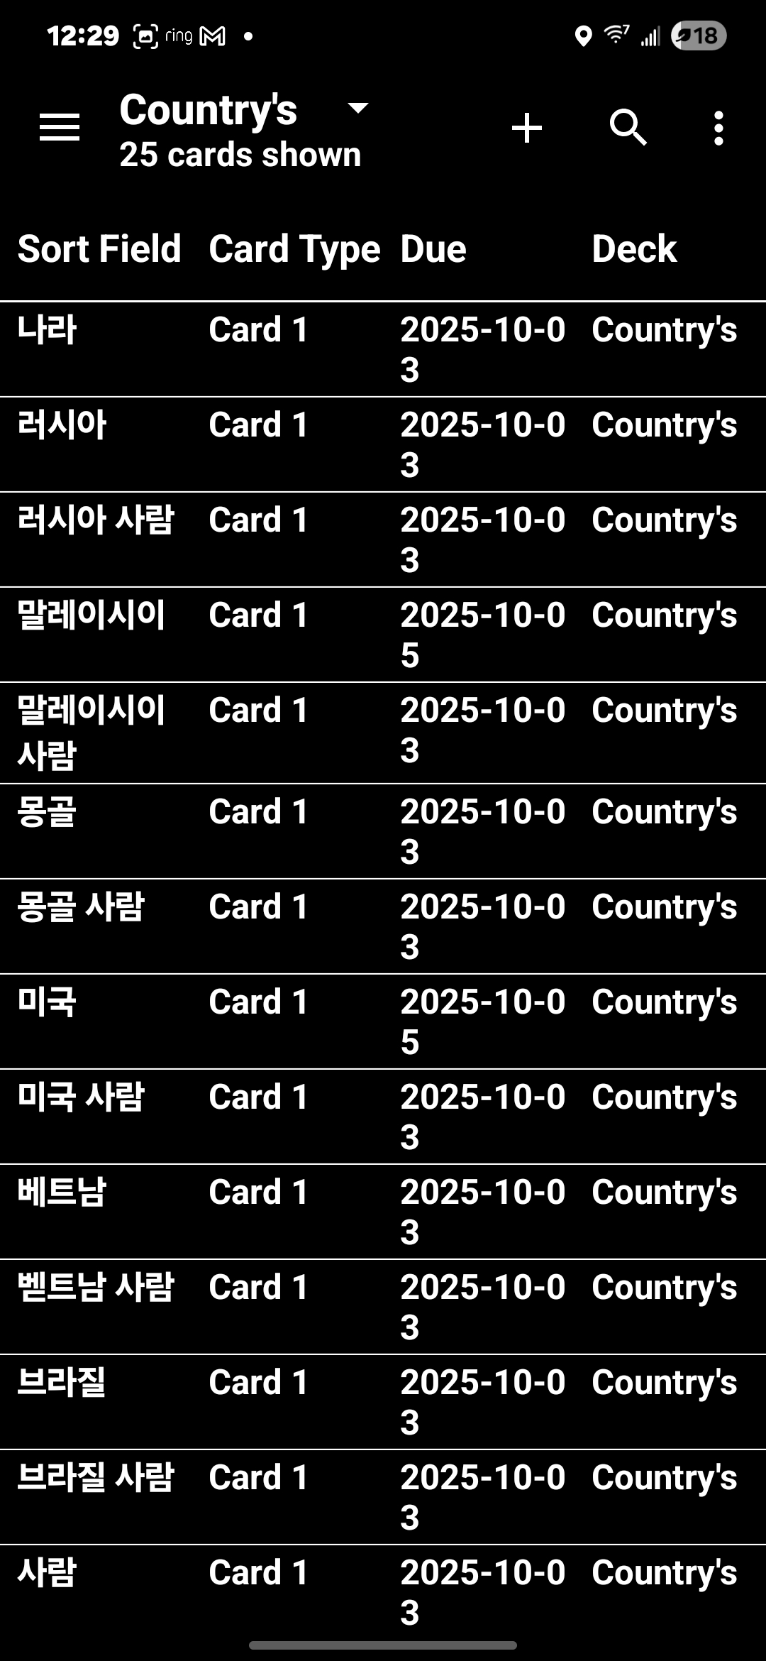
Anki Note Cards
Each card would have Korean and English word
I made at least 2 set for each chapter
Each vocab would be separate and would have one with all words
Here one of example of the wards

